Slide 1
Detecting Covid-19 Vaccine Misinformation from Twitter Dataset
Shashwat Mishra, Mithila Nigudkar, Arpith Rao

Slide 2
Motivation
Covid-19 Pandemic
Rise of social media
Twitter
Fake news
Combating misinformation on Twitter
Finding users who spread misinformation
Checking whether or not they are verified

Slide 3
Problem definition
Building a search engine, that can test key words that have been determined by statistical analysis against a Tweets Database
Returning a result of top 10 Tweets that are most similar to these specified keywords
Performing statistical summary of the results obtained for all the Tweets/Usernames that are returned from the phrase query.

Slide 4
Key Issues
Detecting misinformation from Tweet dataset
Identifying the user spreading the misinformation is verified or not.
Getting a high degree of accuracy (Number of misinformation Tweets/Number of Tweets returned)
We judged accuracy manually by going through the tweets and checking their context

Slide 5
Alternative ways to Resolve Key Issues
Brute Force approach
Limitation:
Takes too much processing power and time
Human Moderators:
Limitation:
There’s only so many Tweets that can be handled by humans,
Sentiment Analysis

Slide 6
Methodology
First, we get a collection of Tweets
Each Tweet is a document, which has it’s own doc id
All the terms present in the tweets will be tokenized, and all the terms are selected and made into a term list
Now using VSM, for each term TF IDF is calculated for the document(Tweet) it is present in
User inputs a multiple term phrase query, we calculate the cosine similarity between the phrase query and the result set of applying VSM on our initial tweets database
We get an output in ranked in descending order of similarity with the phrase query and Tweets
We then detect the usernames of the authors of the resultant tweets. We then check if they’re verified profiles or not

Slide 7
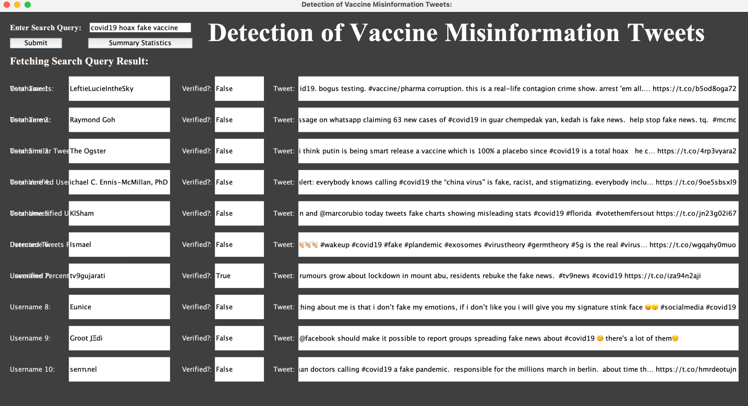
Validation
Accuracy : 5/10 Test cases : covid19 hoax fake vaccine

Slide 8
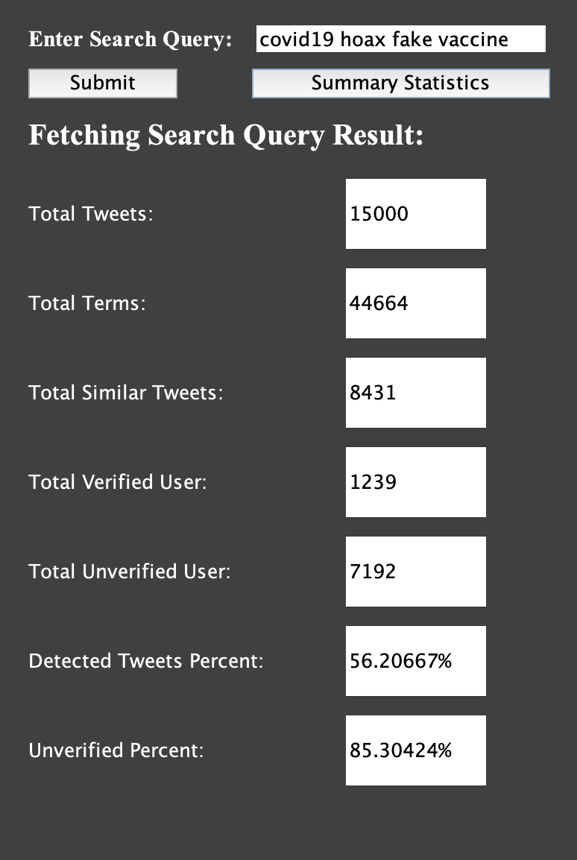
Validation(continued)

Slide 9
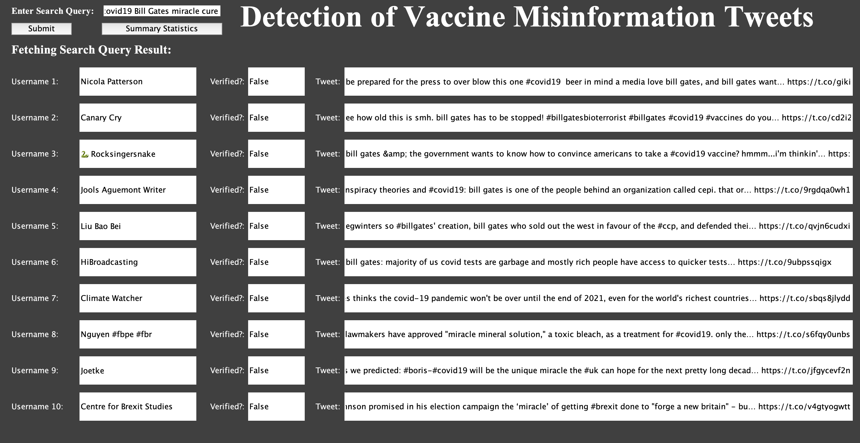
Validation(continued)
Accuracy : 6/10 Test Cases: Covid19 Bill Gates Miracle Cure

Slide 10
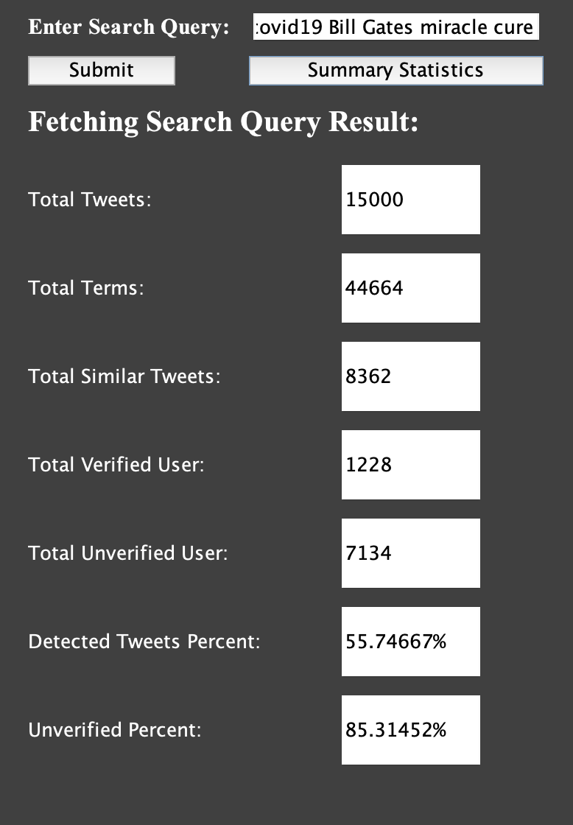
Validation(continued)

Slide 11
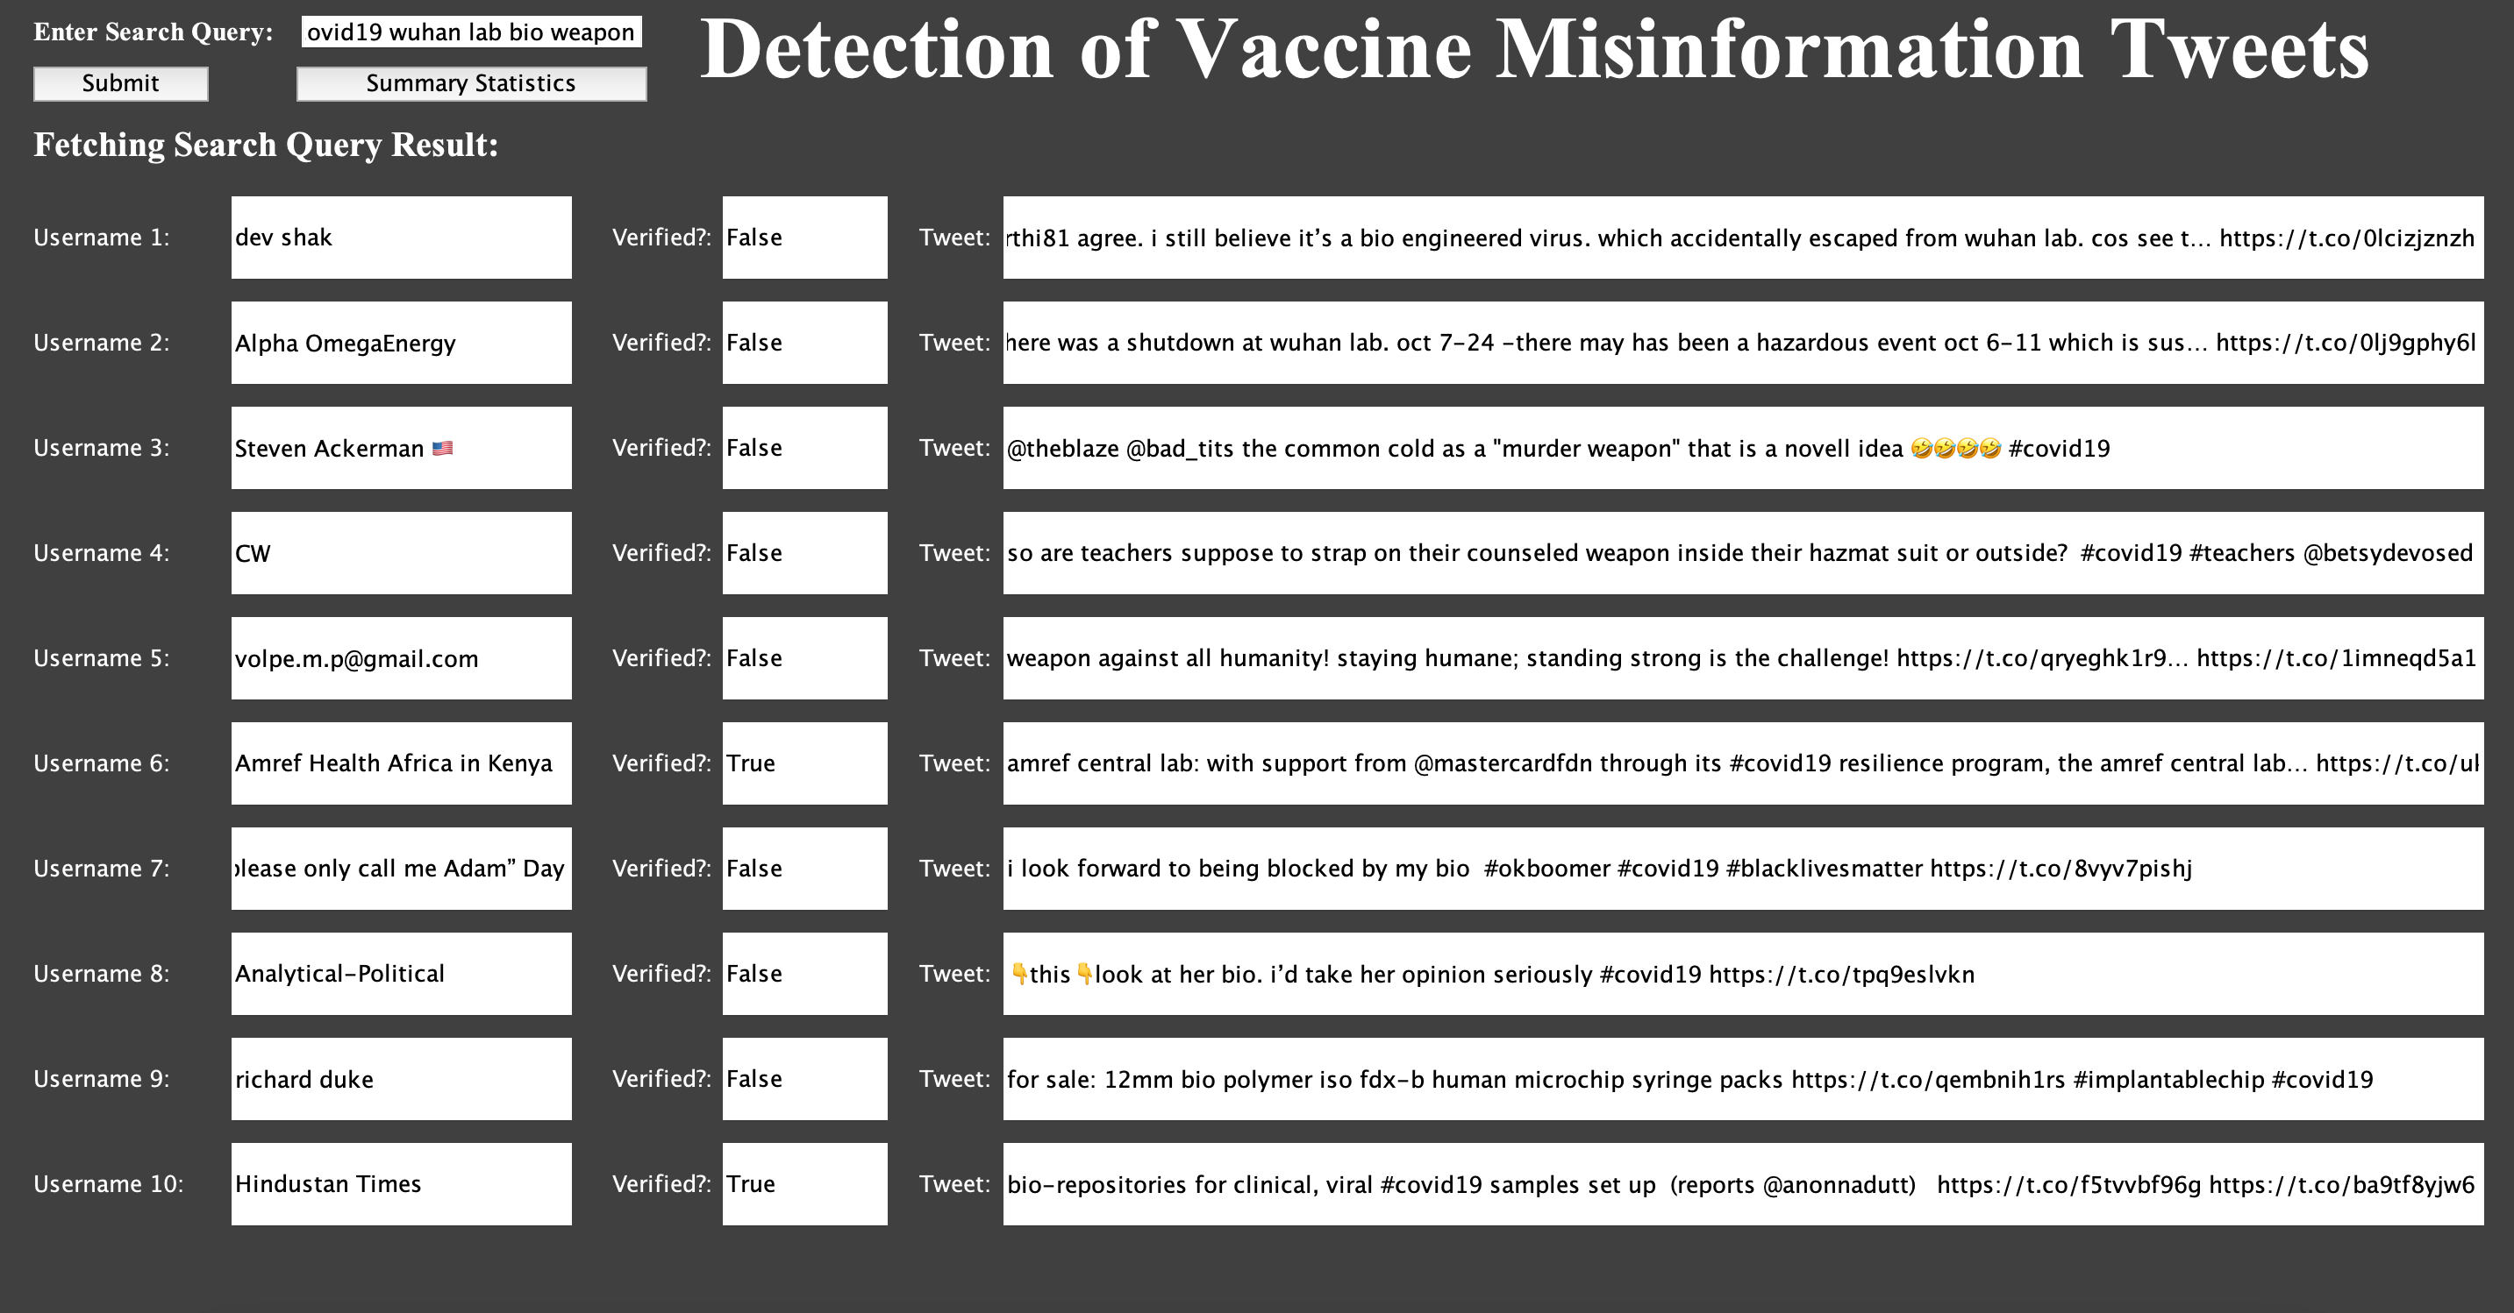
Validation(continued)
Accuracy: 7/10 Test case: Covid 19 wuhan lab bioweapon

Slide 12
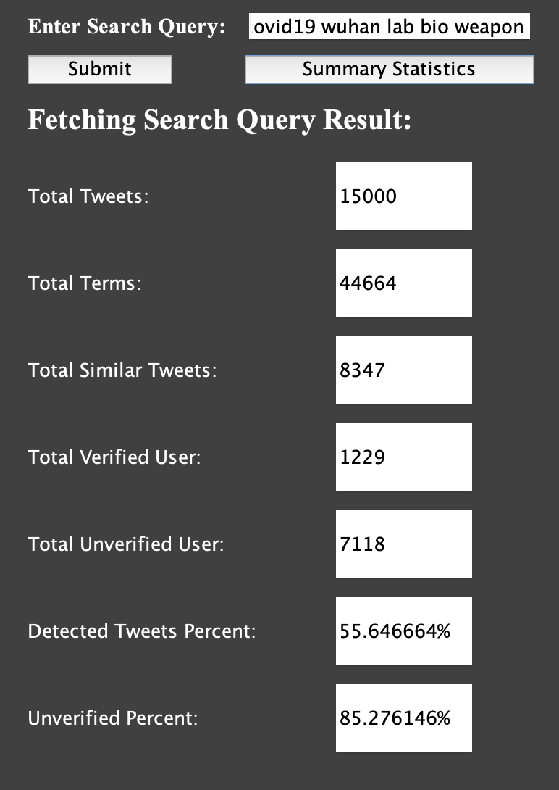
Validation(continued)

Slide 13
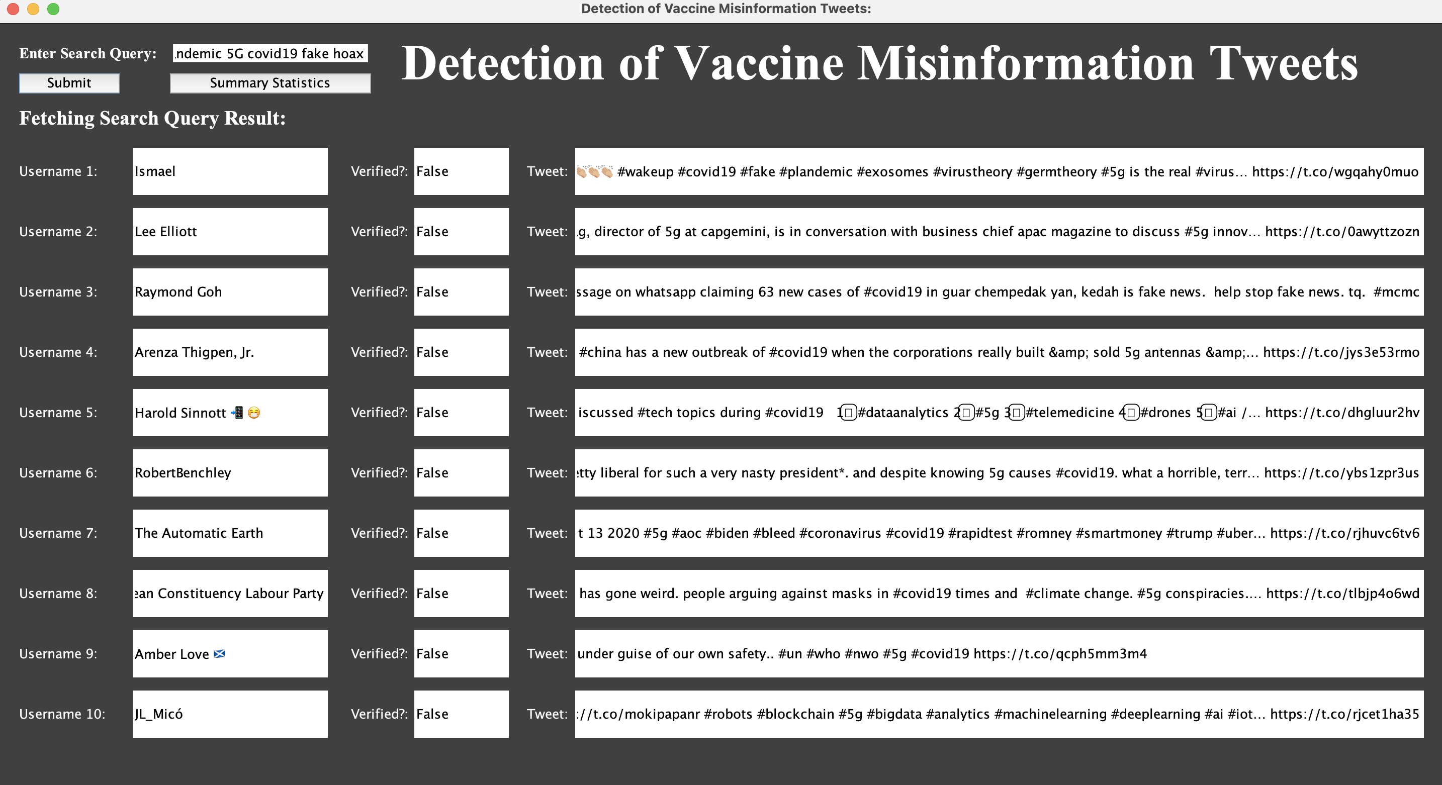
Validation(continued)
Accuracy: 8/10 Test Cases : Pandemic Covid19 5g fake hoax

Slide 14
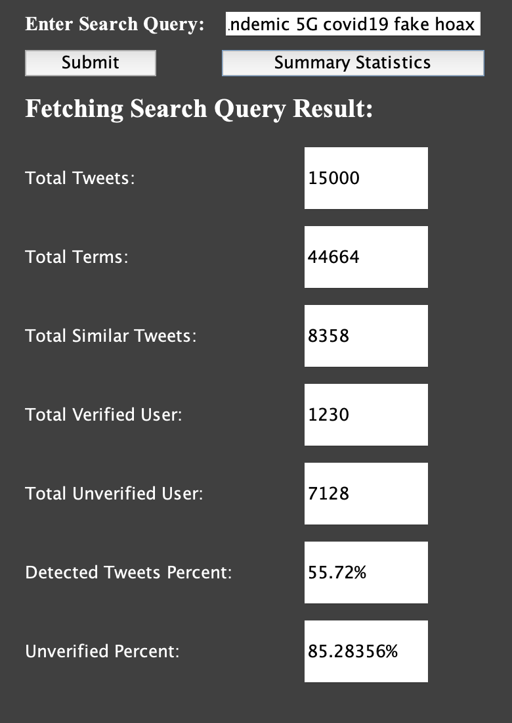
Validation(continued)

Slide 15
Conclusions
Users who spread misinformation have successfully been identified, and can now be reported.
A combination of a human and computer based approach might work best for detecting misinformation.

Slide 16
Future Work
Deploying on different platforms
Applying sentiment analysis to detect sarcasm and negation
Applying it on a the live Twitter API

Slide 17
Thank You!!

